Slide 1
Equities Modeling Using
VIBRATIONS
Modeling via
Matlab
Example Stock:
INSM
Insmed, Inc. (INSM)
NasdaqCM
2/20/2011 event
FDA releases drug Arikace
By Raul Garcia
Developer & Mathematician
https://www.raulegarcia.com/

Slide 2
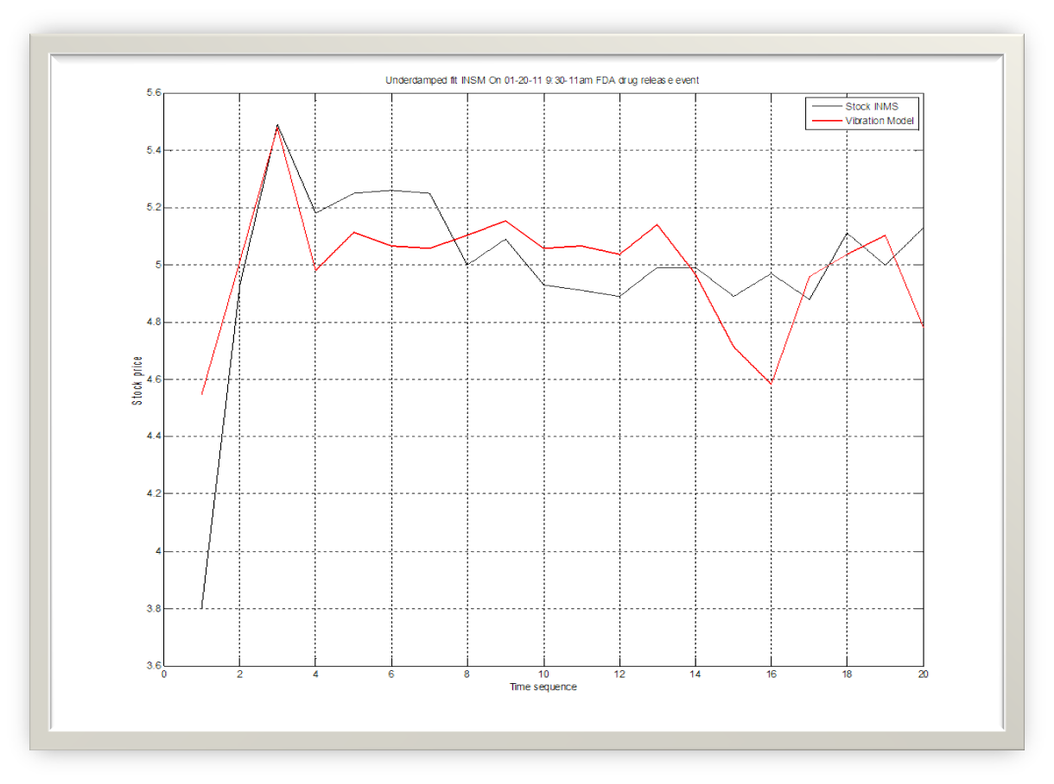
Main Result
Stock prices vs Vibration Model

Slide 3
Motivation
When a stock has positive news it may affect the stock price suddenly upwards
But how much will it jump is not always clear as it depends on many factors like demand, news & timing, the stock sector, dow, market macro economics, stock popularity etc.
But the one thing we know is that often it will jump and then settle down – so this is similar to the behavior of vibrations
Engineering has a rich set of theories and formulas to model vibration
Note that these math models may turn out to be unstable in some cases
We use here one such vibrations model
In this case the fit of the model to the stock top price was nearly perfect

Slide 4
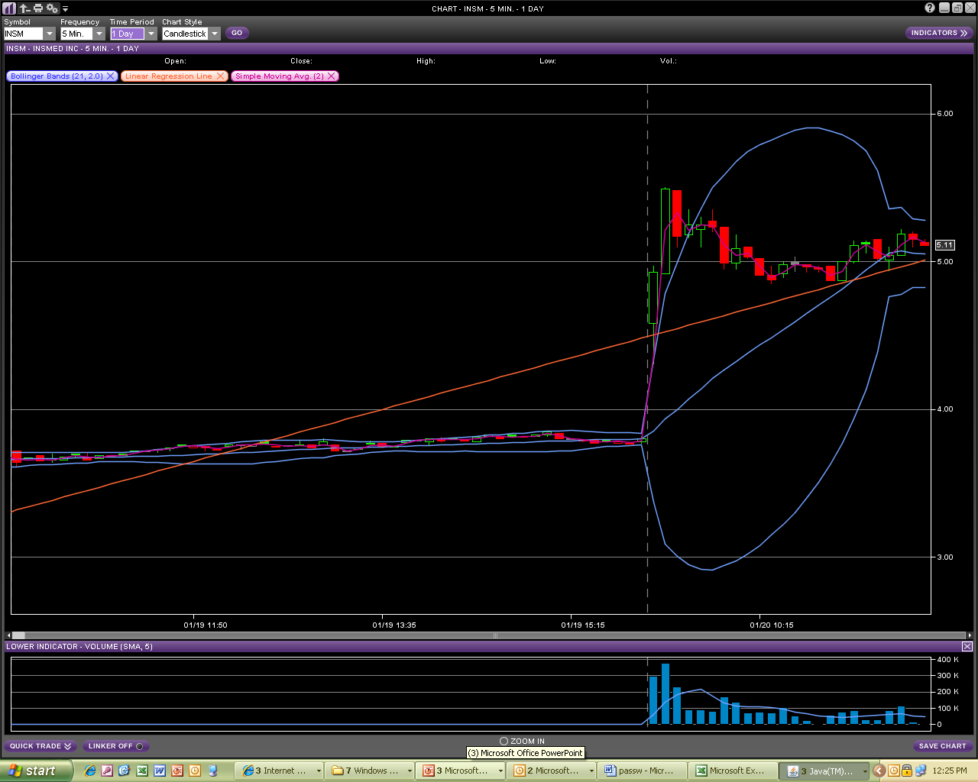

Slide 5
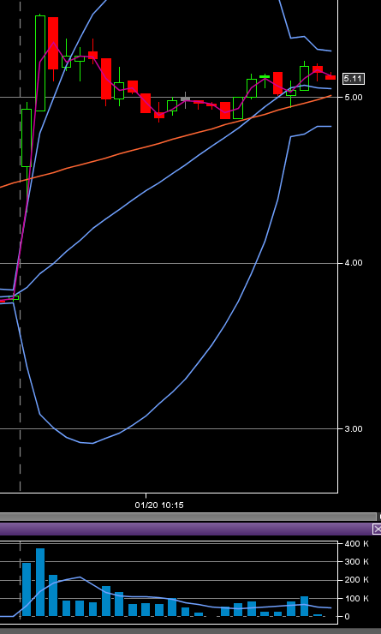

Slide 6
In play 1/20/2011
8:02AM Insmed announced that the FDA has lifted the clinical hold previously placed on Arikace (INSM) 3.80 : Co continues to engage in discussions with FDA regarding the clinical hold placed on ARIKACE in cystic fibrosis patients with Pseudomonas lung infections. Co also announced that it will move ahead with the 9-month dog inhalation toxicity study of ARIKACE as previously requested by FDA to determine if the findings of the rat inhalation carcinogenicity study are observed in a non-rodent model.

Slide 7
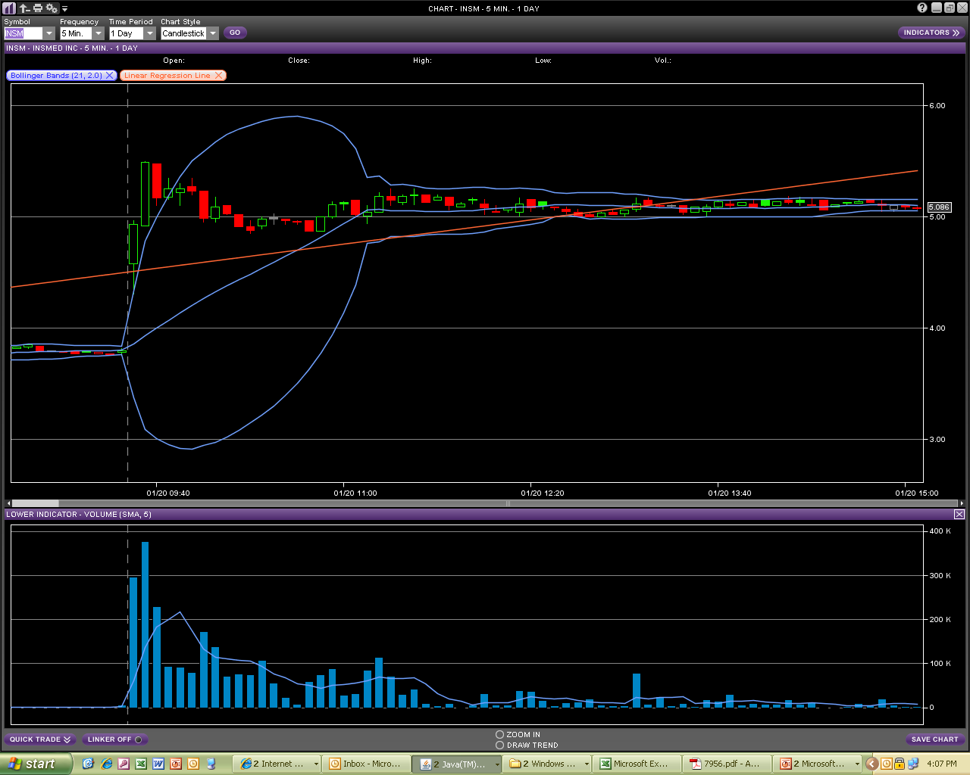
CLOSE 5.05 VOL 2,500

Slide 8
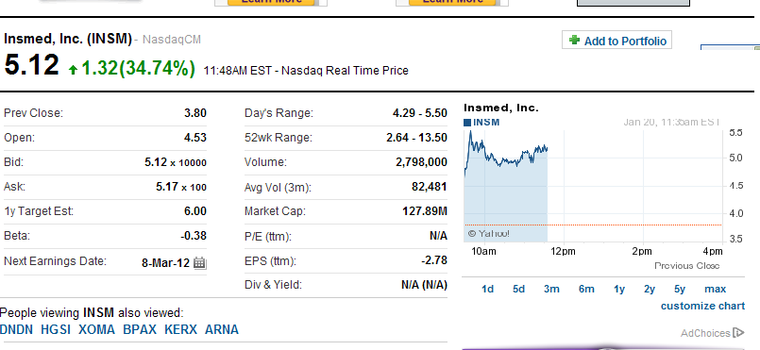

Slide 9
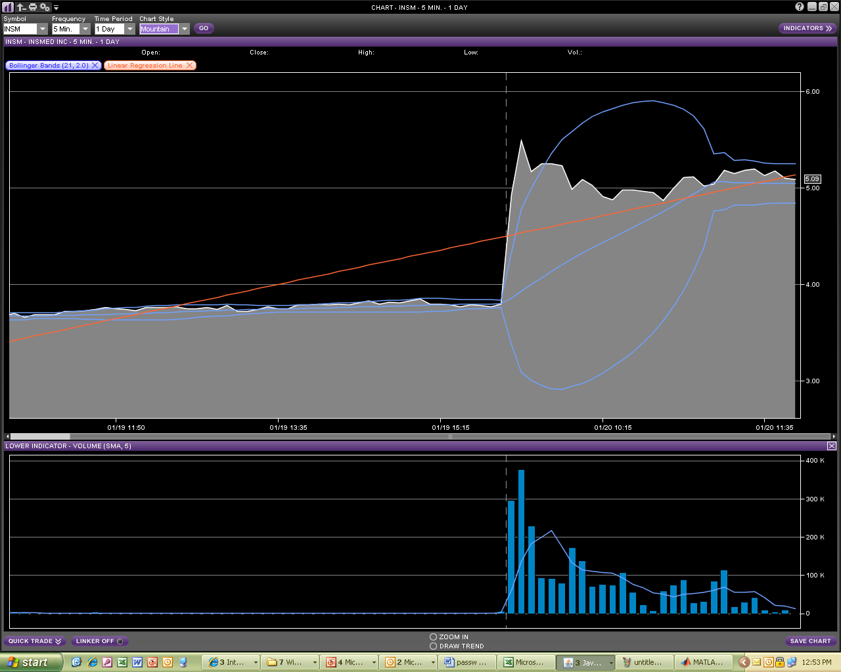

Slide 10
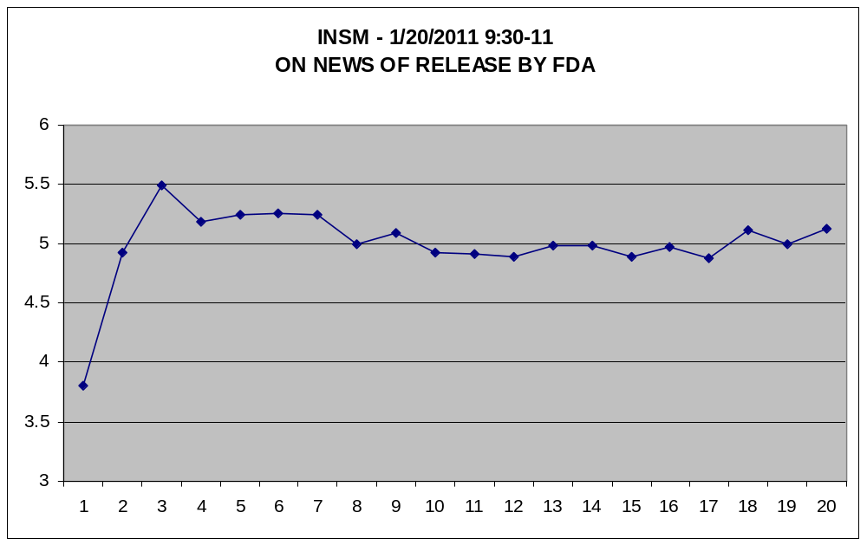

Slide 11

5 MIN INTERVALS INTRADAY 1/20/2011 INSM
DATE | TIME | CLOSE | VOL | NOTES
1/19/2011 | 4:00:00 PM | 3.80 | 6,700 | PREV CLOSE
1/20/2011 | 9:30:00 AM | 4.93 | 300,000
1/20/2011 | 9:35:00 AM | 5.49 | 377,411 | 1ST MAX, 2ND PT
1/20/2011 | 9:40:00 AM | 5.18 | 230,407
1/20/2011 | 9:45:00 AM | 5.25 | 96,348
1/20/2011 | 9:50:00 AM | 5.26 | 80,879 | 2ND MAX, 5TH PT
1/20/2011 | 9:55:00 AM | 5.25 | 79,161
1/20/2011 | 10:00:00 AM | 5.00 | 175,408
1/20/2011 | 10:05:00 AM | 5.09 | 141,000
1/20/2011 | 10:10:00 AM | 4.93 | 79,161
1/20/2011 | 10:15:00 AM | 4.91 | 80,879
1/20/2011 | 10:20:00 AM | 4.89 | 74,004
1/20/2011 | 10:25:00 AM | 4.99 | 108,379
1/20/2011 | 10:30:00 AM | 4.99 | 60,225 | DOJI
1/20/2011 | 10:35:00 AM | 4.89 | 24,881
1/20/2011 | 10:40:00 AM | 4.97 | 10,412
1/20/2011 | 10:45:00 AM | 4.88 | 58,836
1/20/2011 | 10:50:00 AM | 5.11 | 74,004
1/20/2011 | 10:55:00 AM | 5.00 | 91,912
1/20/2011 | 11:00:00 AM | 5.13 | 32,755 | DOJI
Since the stock gapped from the prev day close of 3.8 and started at 4.93 the max was achieved quickly at 9:35 am
Note we don’t include the pre-open trade data

Slide 12
Main result
Compare the fit to the actual stock prices

Slide 13
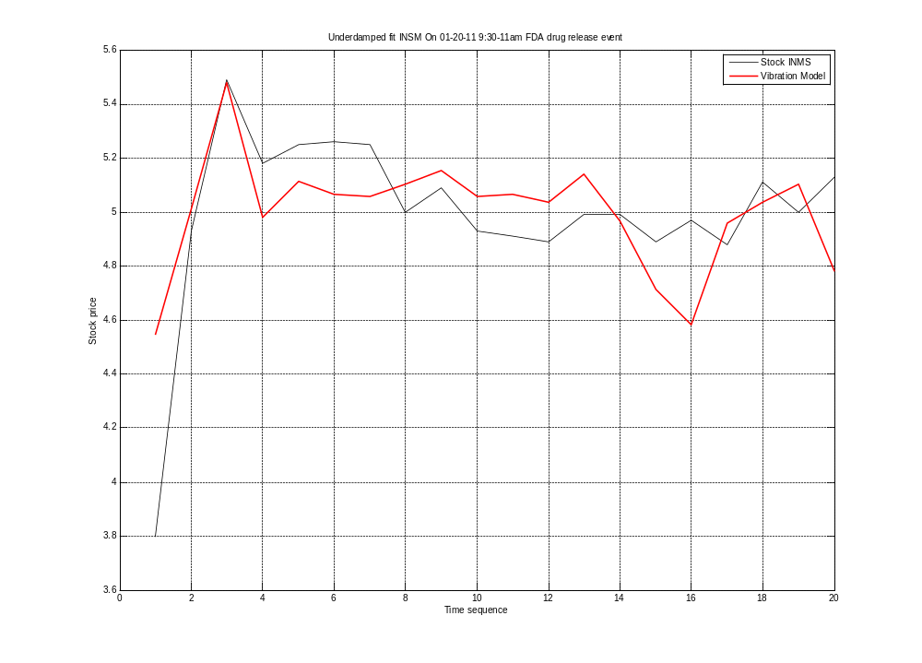

Slide 14
Conclusion
Great – the under damped vibration model worked using normalized stock VOLUME data
When doing the plot we need to use a sequence for time since we can not use volume since its not sequential
Note – lsqnonline did not work on pure volume data, it gave a singular matrix error, we divide v by its max value
The X0=[1 1 1 1 1] initial value was better than X0*p(1)
It worked because the top value of the period 9:30am-11 matched on the same time, on the time 9:35 am
We had only two data pts on the same day 1/21/12 for 9:30 and 9:35 and their volumes
Note we started on the close the prev day to account for the gap in between days
The high was too soon to be able to have enough data points, we can consider using pre-market data here
This is a precursor result since it paves the way to use volume as a possible predictor in the future when we have enough initial data points and the peak price happens after 5 or more periods

Slide 15
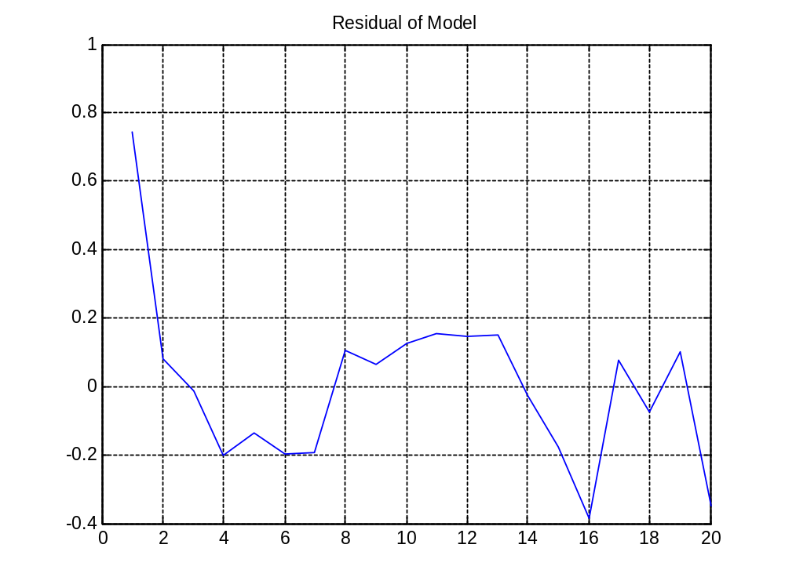
The model coefficients results C1 to C5 and the residual plot
1.93543161625874
4.47814142327816
1.57709028256595
-1.34612288813903
-3.01001476547738
Residual norm 1.1225

Slide 16
Algorithm run data
First-Order Norm of
Iteration Func-count Residual optimality Lambda step
0 7 224.628 80.3 0.01
1 14 44.4983 31.2 0.001 5.03159
2 23 22.202 55.6 0.1 1.2453
3 31 1.42679 0.809 1 0.411893
4 38 1.37724 0.455 0.1 0.11378
5 46 1.3519 0.147 1 0.103813
6 53 1.32652 0.173 0.1 0.108399
7 61 1.29918 0.189 1 0.112054
8 68 1.27078 0.205 0.1 0.113857
9 76 1.24259 0.214 1 0.113023
10 83 1.21619 0.212 0.1 0.10896
11 91 1.19309 0.197 1 0.101463
12 98 1.1744 0.182 0.1 0.0909138
13 105 1.1512 2.71 0.01 0.303832
14 113 1.13292 0.166 0.1 0.111557
15 120 1.13068 0.213 0.01 0.101522
16 128 1.12849 0.243 0.1 0.0992351
17 135 1.12649 0.233 0.01 0.0933659
18 143 1.12488 0.193 0.1 0.0829384
19 150 1.12376 0.136 0.01 0.0685736
20 158 1.1231 0.0808 0.1 0.0524652
21 165 1.12277 0.0415 0.01 0.0373466
22 172 1.12256 0.168 0.001 0.069486
23 179 1.12252 0.000932 0.0001 0.00318223
24 186 1.12252 7.71e-006 1e-005 0.000487263

Slide 17
Matlab M-code
importfile('INSM-IMPORT_DATA.xls')
% loads data into variable named data with t,p - time series and prices
v=data(:,1)'; % volume
p=data(:,2)'; % price per 5 mins
% locally singlur issue with vol data as is
% try to make it bet 0 and 1
V=v;
vmax=max(v)
v=v/vmax;
% Initialize the coefficients of the function
f=1
X0=[1 1 1 1 1 1]'*f, % -- 1 PERFORMS BETTER THAN f=p(1)
% Set an options file for LSQNONLIN to use the
% maxfunevals default of 800 not sufficient
options1 = optimset('Display','iter','MaxIter',20000,'Largescale','off','MaxFunEvals',20000);
options2 = optimset('Display','iter','MaxIter',20000,'MaxFunEvals',20000);
% Calculate the new coefficients using LSQNONLIN
[x,resnorm,residual,exitflag,output,lambda,jacobian] =lsqnonlin(@fit_undamped3,X0,[],[],options1,v,p);
C1=x(1)
C2=x(2)
C3=x(3)
C4=x(4)
C5=x(5)
% plot solution
% cant plot vol x price since vol is not linear as time
[n m]=size(p)
% for X=1:m
% Y(X)=exp(C1.*v(X)).*(C2.*cos(C4.*v(X)) + C3.*sin(C5.*v(X)));
% end
X=1:m % --- use only a simple sequence scale for X
Y(X)=exp(C1.*v(X)).*(C2.*cos(C4.*v(X)) + C3.*sin(C5.*v(X)));
% note we evaluate Y on values of the normalized volume v(X)
P=[X,Y]
% note we plot real volumes V and prices
figure
plot(X,p,'-k') % stock chart
hold on
plot(X,Y,'-r','LineWidth',2) % model chart
grid on
title 'Underdamped fit INSM On 01-20-11 9:30-11am FDA drug release event'
xlabel 'Time sequence'
ylabel 'Stock price'
legend('Stock INMS','Vibration Model')
figure
plot(X,p,'-r')
grid on
title 'Biotech INSM On 01-20-11 9:30-11am FDA drug release hold event Arikace'
xlabel 'Time sequence'
ylabel 'Stock price'

